Slide 1
Technical Offerings
Training, education and opportunities for personal advancement
Christopher Kusek - Peters & Associates
Notes:
I know we've heard it all before.
TechNet provides some great benefits to help IT Professionals do their job effectively.
We've heard that, and we know how great it really is, they provide us all this content!
So much still yet, do we really even have any idea exactly how much they're providing?

Slide 2
Table of Contents
Microsoft Resources
Live and Online
  Microsoft Virtual Labs
  Microsoft Webcasts
On the Go
  Microsoft VHD’s
  Microsoft Podcasts
  Microsoft TechEd DVD sessions
  Microsoft TechNet Magazine
  TechNet Radio
On the Go
  O’Reilly Safari
  Blogs
Christopher Kusek - Peters & Associates

Slide 3
Microsoft Virtual Labs
TechNet Virtual Labs
MSDN Virtual Labs
Branch Office
Identity and Access (IDA)
Internet Information Services (IIS)
Security
Windows Mobile
Windows Server “Longhorn”
Windows Server 2003
Microsoft Antigen
Microsoft Identity Integration Server (MIIS) 2003
SQL Server 2000, 2005 & 2005 Upgrade
2007 Microsoft Office system
Microsoft Exchange Server 2003 & 2007
Windows Vista
ASP.NET 2.0
ASP.NET
BizTalk Server
Commerce Server
Fritz Onion's Intro to ASP.NET
Internet Information Services (IIS)
JPlusN (J+N)
Microsoft Expression
.NET Framework 3.0
Soup to Nuts
Visual Studio .NET 2003
Visual Studio 2005
Visual Studio Team System
Visual C#
Visual J#
Visual Basic
Visual C++
RMS, SMS,LCS, and more!
Microsoft Operations Manager 2005
Share Point Portal Server
Internet Security and Acceleration Server (ISA) 2004 & 2006
Christopher Kusek - Peters & Associates
Notes:
http://www.microsoft.com/events/vlabs/default.mspx - Virtual Labs
http://www.microsoft.com/technet/traincert/virtuallab/ - TechNet Featured Labs
http://msdn.microsoft.com/virtuallabs/ - MSDN Featured Labs

Slide 4

Microsoft Webcasts
Available as Live or On-Demand
Speeches and Keynotes available
Download as WMV or LiveMeeting
Available as On-Demand RSS Feed
Christopher Kusek - Peters & Associates
Notes:
http://www.microsoft.com/events/default.mspx - Events and Webcasts main page
http://www.microsoft.com/events/webcasts/ondemand.mspx – On-Demand Webcasts

Slide 5
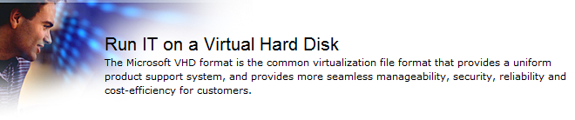
Microsoft VHD’s
Evaluate Pre-Configured software solutions
Isolation – Test that solution on the go.
Freely available Industry Content
Virtual PC and Virtual Server - Free Downloads
Christopher Kusek - Peters & Associates
Notes:
http://www.microsoft.com/technet/try/vhd/default.mspx - Microsoft VHD’s

Slide 6
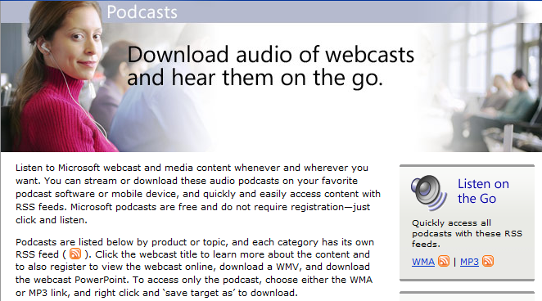
Microsoft Podcasts
Listen on the go
WMA or MP3
Content for IT Professionals and Managers
RSS Feed
Christopher Kusek - Peters & Associates
Notes:
http://www.microsoft.com/events/podcasts/default.mspx – Microsoft Podcasts
WMA - 32K 22khz
MP3 - 48K

Slide 7
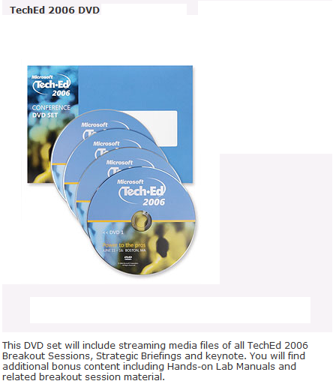
Microsoft TechEd DVD Sessions
Breakout Sessions
Demos and PowerPoint slides from sessions
Content can be copied down to local disk to be viewed whenever
32GB of sessions and high quality content, tailored to your specific needs.
Each session about 75 minutes in length.
Christopher Kusek - Peters & Associates

Slide 8

TechNet Magazine
Free subscription to IT Professionals
Free online access to back issues
Articles available in PDF Download
Monthly Podcast
RSS Feed
Christopher Kusek - Peters & Associates
Notes:
http://www.microsoft.com/technet/technetmag/default.aspx - TechNet Magazine
http://www.microsoft.com/technet/technetmag/subscribe.aspx - Magazine Sub

Slide 9

TechNet Radio
Industry and Peer perspectives
New Episodes weekly
Available in WMA, MP3 High and MP3 Low
RSS Feed for WMA and MP3-Low
Christopher Kusek - Peters & Associates
Notes:
http://www.microsoft.com/technet/community/tnradio/default.mspx - TechNet Radio
http://www.microsoft.com/technet/community/tnradio/archive/default.mspx - TechNet Radio Archive
Welcome to Microsoft TechNet Radio, a radio show for IT Pros. We'll bring you the trends and technologies that are shaping our industry, and offer perspectives from your peers. Look for new episodes of TechNet Radio weekly, or subscribe via the RSS feed below and let the shows come to you.
Personally, I think the WMA comes off as more ‘tinny’ than the MP3 equivalent.
WMA 20kbps - 20min, 3.1mb
MP3Hi - 48kbps - 20min 7.1mb
MP3Lo - 24kpbs - 20min, 3.5mb
Only complaint I have is, it is not obvious on when a specific session was recorded when you look in the Archives, trying to match a date to a session.
You can find it if you go into each specific session and hover over the downloadable file and you’ll find its date there, e.g.. 061114 as an example or by downloading the file it’ll be obvious there.

Slide 10

O’Reilly Safari Library
Large Library in E-book Format
Some content before Publishers go to Press
Access to Videos with Library subscription
PDF Download of content chapters
Christopher Kusek - Peters & Associates
Notes:
http://safari.oreilly.com/ - O‘Reilly Safari

Slide 11

Blogs
Content updated by Microsoft Employees
Content updated by Industry Professionals
Informal Tone, updated frequently
Honest opinions
Christopher Kusek - Peters & Associates
Notes:
http://www.pkguild.com – Christopher Kusek – Technology Blog
http://www.microsoft.com/communities/blogs/PortalHome.mspx - MS Blogs
http://blogs.technet.com/uc/default.aspx - Unified Communication Blog
http://blogs.technet.com/exchange/default.aspx - Exchange Team Blog

Slide 12
Resources
http://www.microsoft.com/events/vlabs/default.mspx – Virtual Labs
http://www.microsoft.com/events/default.mspx – Microsoft Events and Webcasts
http://www.microsoft.com/technet/traincert/virtuallab/ – TechNet Featured Labs
http://msdn.microsoft.com/virtuallabs/ – MSDN Featured Labs
http://www.microsoft.com/technet/try/vhd/default.mspx - Microsoft VHD’s
http://www.microsoft.com/events/podcasts/default.mspx – Microsoft Podcasts
http://www.microsoft.com/technet/technetmag/default.aspx – TechNet Magazine
http://www.microsoft.com/technet/technetmag/subscribe.aspx – Magazine Sub
http://www.microsoft.com/technet/community/tnradio/default.mspx – TN Radio
http://safari.oreilly.com/ - O‘Reilly Safari
http://www.pkguild.com – Christopher Kusek – Technology Blog
http://www.microsoft.com/communities/blogs/PortalHome.mspx - MS Blogs
http://blogs.technet.com/uc/default.aspx - Unified Communication Blog
http://blogs.technet.com/exchange/default.aspx - Exchange Team Blog
http://www.imginc.com – Information Management Group Website
Christopher Kusek - Peters & Associates

Slide 13
Questions, Comments, Feedback
Christopher.Kusek@PKGuild.com
For additional content, visit my Blog
http://www.pkguild.com
Christopher Kusek - Peters & Associates

